Slide 1


CeeVeasily
Kabelo M Rankaone- 2603828
Nathan Joesph- 2540381
Tapiwa Mazarura- 2581366
Notes:
Good Day. My name is Tapiwa Mazarura and together with my colleagues Kabelo Rankoane and Nathan Joseph, we have created a Machine Leaning solution to revolutionize CV and resume making. Presenting CeeVeasily , Your path to CV perfection.

Slide 2


Problem
There is a lot of global unemployment
A big problem for the unemployed is generating competitive CV’s
Many employers discard prospective employees because of missing information and poorly structured CV’s
Notes:
It’s no secret that there is a big problem with unemployment across the globe. We often underestimate the impact a bad CV on an application can have. A CV is often the first impression a prospective employer has of an applicant, and this greatly influences whether to take your application forward.

Slide 3


Beneficiaries and Opportunity
Beneficiaries:
Students
Graduates
Unemployed
Employers – they will have the correct info needed therefore more streamlined approach to recruitment
Opportunity:
Templates don’t help
No current system that gives feedback on CV
Too much variety in how CVs look and what information must be there (ie picture vs no picture)
Notes:
So who will benefit from our solution? The beneficiaries of CeeVeasily include students, graduates, the unemployed and in general anyone who applies to a position where a CV is required. Employers can also CeeVeasily to help ensure that they get the most relevant information to make the recruitment process more streamlined.
CeeVeasily is a novel solution to say that we have no direct competitors.
The current system of using templates has too much variety and does not consider the success of the templates success in applications.

Slide 4

Solution Overview
Solution
CeeVeasily offers an innovative machine learning solution to predict and enhance CV quality.
Evaluation:
Test CVs are fed into our model to receive personalized recommendations for improvement.
Data Formatting
Data Collection
ML approach
Notes:
CeeVeasily offers an innovative machine learning solution to predict and enhance CV quality and success. I will now explain how we achieved this and how we evaluated that CeeVeasily is a great solution to this problem.

Slide 5
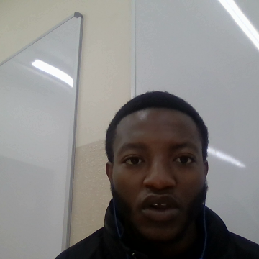
Data collection and formatting
Collection
We collect diverse CVs with their job outcomes from various companies to train our predictive model effectively.
Formatting
We want a unified format of the CVs for consistent analysis
When we get the CVs it can be in the form of a PNG , docx, or pdf. We want it to be in unified form of a PDF
Notes:
One of the most parts of a machine learning solution is the data collection and formatting.
We collected a vast range of CVs from different countries and companies in different fields of work and the success or failure of each CV application. These came in many formats including PDF, png and docx.
In formatting we converted all the CVs to PDF format for consistent analysis.

Slide 6
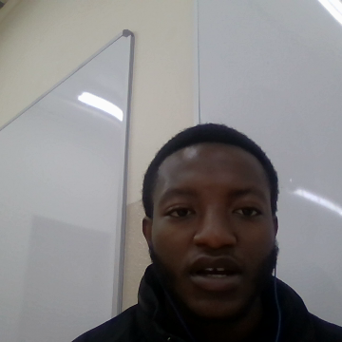
ML Approach
Learning Type
Supervised Learning
Labelled data consists of different CV types and the outcomes of the applications.
Algorithm and Feature’s
Probabilistic prediction using Naïve Bayes
Features of the data include whether the CV has a profile picture, the sequence of information and the types of information included or excluded.
Notes:
Now for the ML approach.
We used supervised learning to train our model. The training data consisted of different CVs and the outcomes of each of them.
We made use of a probabilistic prediction using the Naïve Bayes.
Some of the features used in learning and prediction include whether a CV has a profile picture, the sequence of information and the information included or excluded.

Slide 7

Issues in fitting
Under-fitting
There is a risk of oversimplifying CV analysis (too little features) , leading to inadequate recommendations.
Over-fitting
This could result in overly specific recommendations that may not generalize well to diverse job applications.
Notes:
We would expect issues in fitting
Under-fitting would occur if we oversimplify the differences between the CVs and how they affect the outcome of the application.
For example, if the model focuses solely on keywords or basic formatting, it may miss distinctions in the candidate's experience, skills, or achievements.
For overfitting the model may provide recommendations that are too specific to the training data and do not generalize well to new CVs. This could result in inflexible advice that does not reflect the diverse needs and preferences of job seekers.

Slide 8


Deployment strategy
Parternships
Collaborate with industry leaders such as Linkedin and indeed to enhance user experience and expand market reach.
Implementation:
Offer CeeVeasily as a web-based tool accessible to job seekers worldwide.
Rollout Plan
Integrate CeeVeasily into popular job search platforms like LinkedIn, providing seamless CV analysis for users.
Revenue Model
The partnership with LinkedIn will be the main source of income. As it becomes more popular, we would implement subscriptions to use our services
Notes:
CeeVeasily would be best deployed in partnership with companies like LinkedIn and Indeed who have a large number of both unemployed people and prospective employers who are out the targets for our service.
We offer CeeVeasily as a web based tool that can be used by customers worldwide.
Through our partnership with the aforementioned companies we can easily rollout our product.
Initially our main source of revenue will be from our partners renting our services on their platforms, but as the solution grows in popularity we would implement CeeVeasily as an independent service with a subscription.

Slide 9

Ethical considerations
Data Privacy
We do not want to retain any personal information from our training data (personal CVs)
Safeguards
We will blur out any personal information in training data such as names, pictures and addresses
This can decrease the risk of identity theft
During formatting we block out names and faces (if there are) by blurring them out
This decreases any chance of issues involving identity theft
Notes:
Some ethical considerations come about from the personal nature of CV and their outcomes.
Because of how personal CVs are, we would not like to retain any sensitive information from our training or test data.
How we will achieve this is by blurring any personal information on the CV like names, pictures and addresses in the data formatting stage.
This can decrease the risk of identity theft.

Slide 10

Thank You
We are transforming the landscape of job seeking, empowering individuals to showcase their true potential with well constructed CVs.
Let's shape the future of employment, one CV at a time.
Notes:
We've identified a pressing issue in today's job market: the challenge of crafting compelling CVs that stand out to employers. With CeeVeasily, we're offering a solution that leverages machine learning technology to analyze CVs and provide personalized recommendations for improvement.
By investing in CeeVeasily, you're not just supporting a business venture; you're joining a movement to revolutionize the way people approach job hunting and career advancement. Partner with us and shape the future of employment, one CV at a time.

